Slide 1
Journal now app
Build process for users to login and post stories

Slide 2
Problems to solve
users can log-in, or signup to use app
visitors can view public articles
subscribers can post articles as private or public

Slide 3
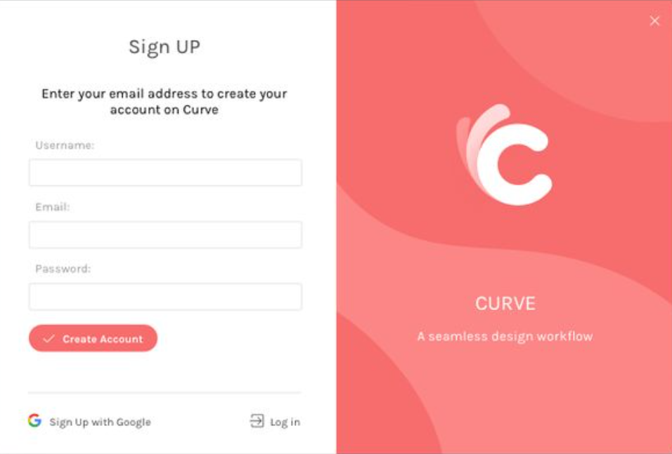
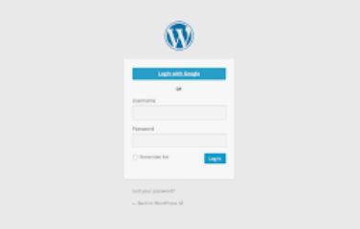
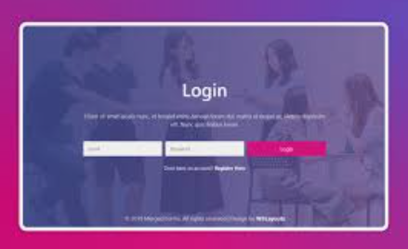
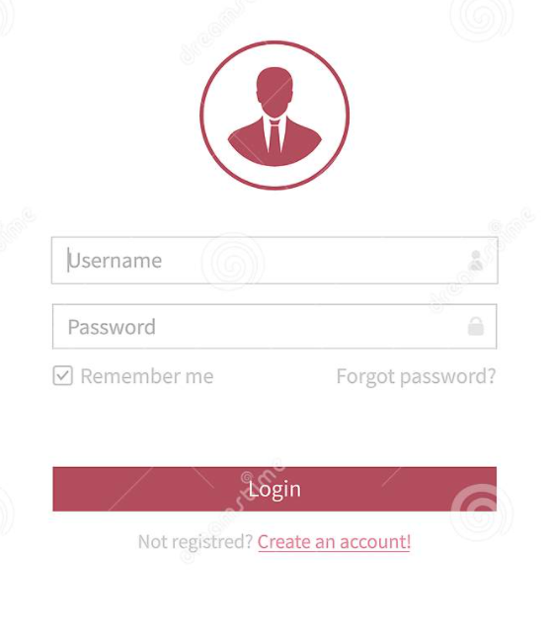
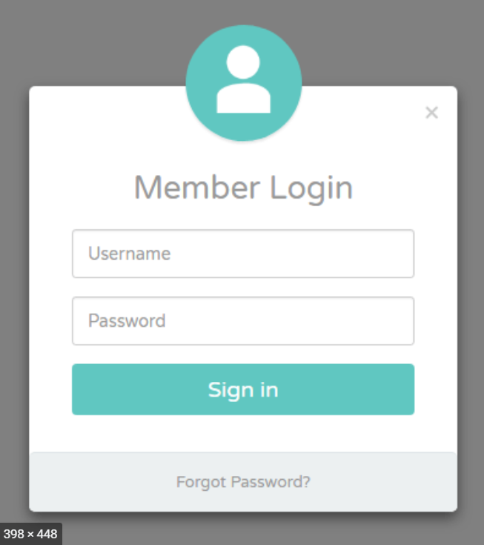
Research
Searched for examples of journal apps
Captured screen shots for design inspiration

Slide 4
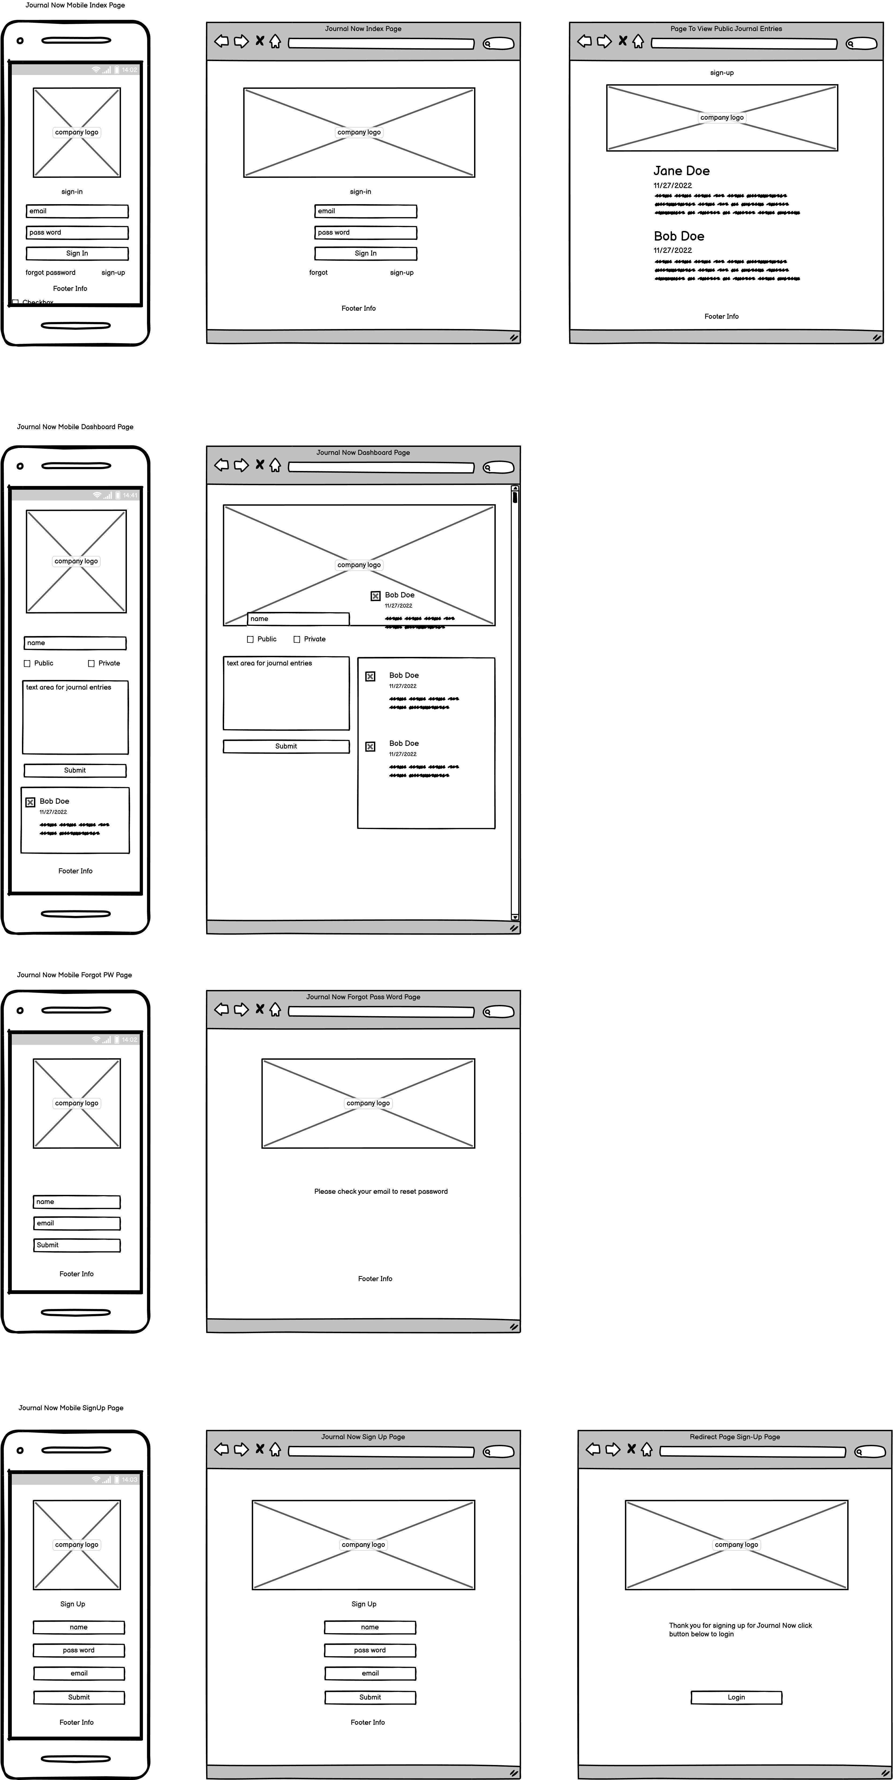
Wireframe
Balsamiq Prototype

Slide 5
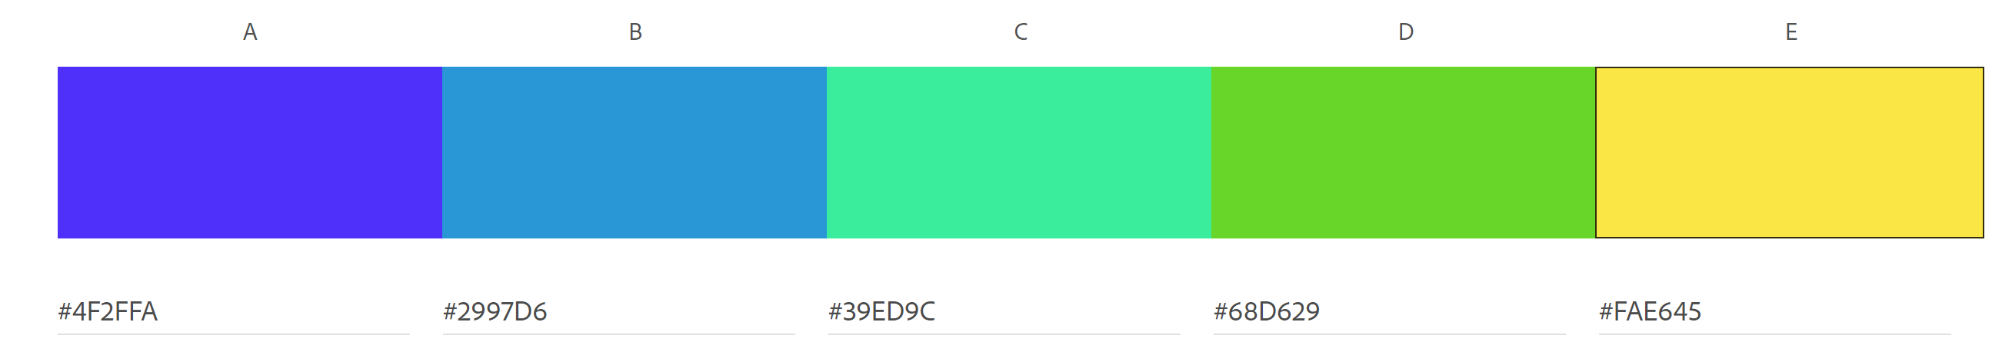
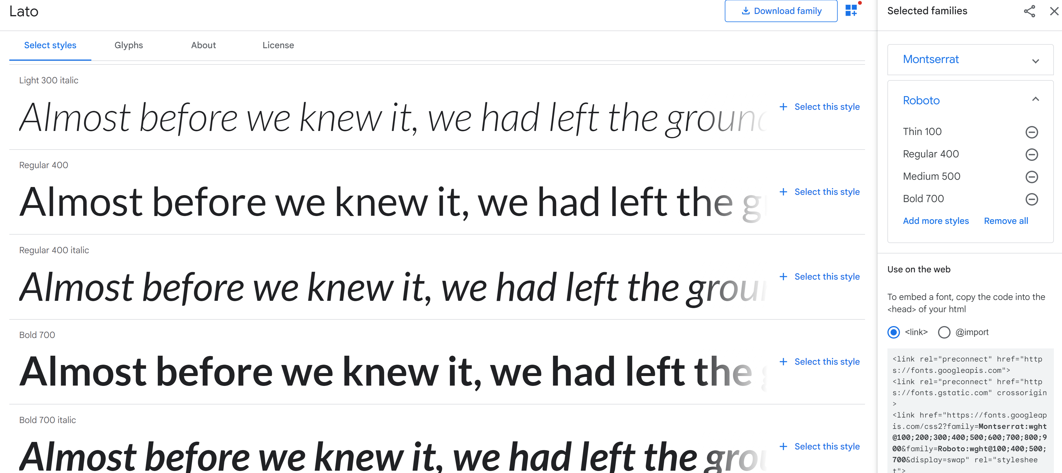
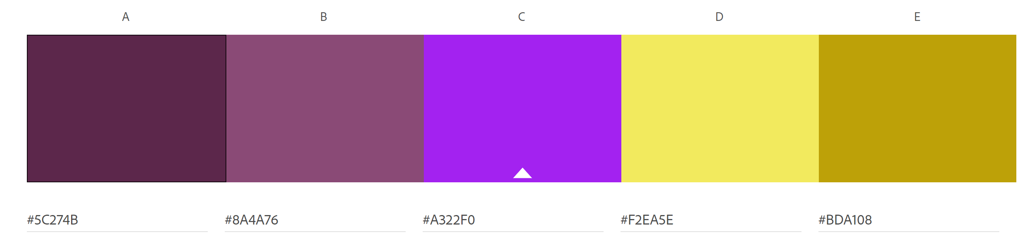
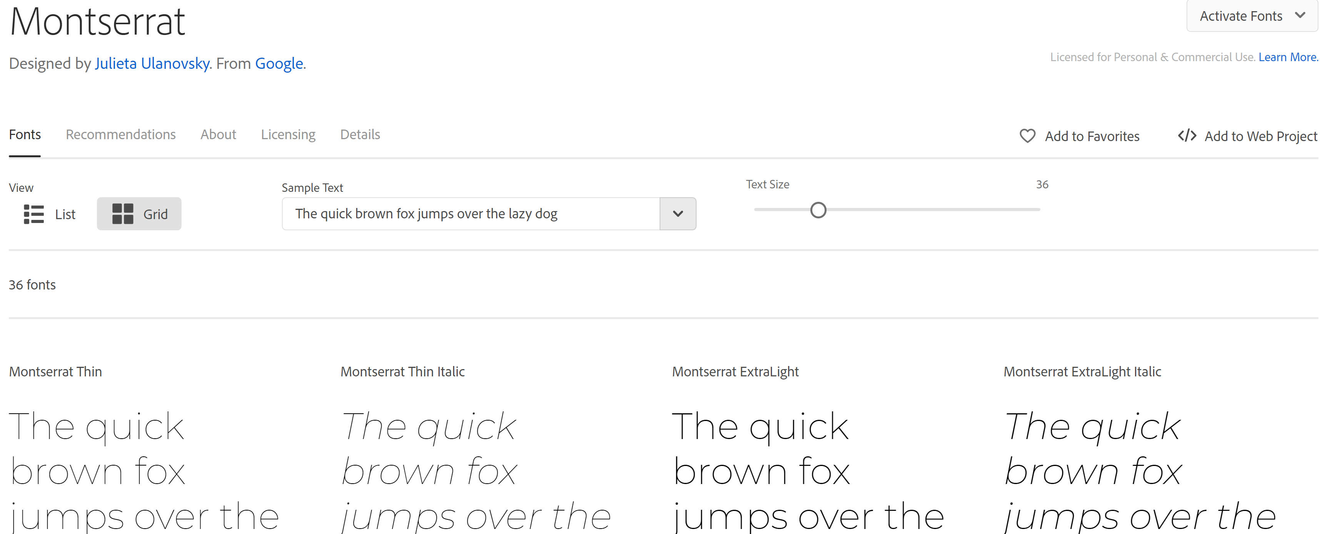

assets
Color Palette
Paletton
Adobe Color CC
ColoRotate
Mudcube Color Sphere
Fonts
fontpair.co
Adobe Fonts
Google Fonts

Slide 6
Created git repository
Created GitHub Repository

Slide 7
html
SET UP HTML
Index page
Dashboard page
Sign-up page
Forgot password page

Slide 8
tailwind CSS
INSTALLED TAILWIND
Styled index
Styled dashboard page

Slide 9
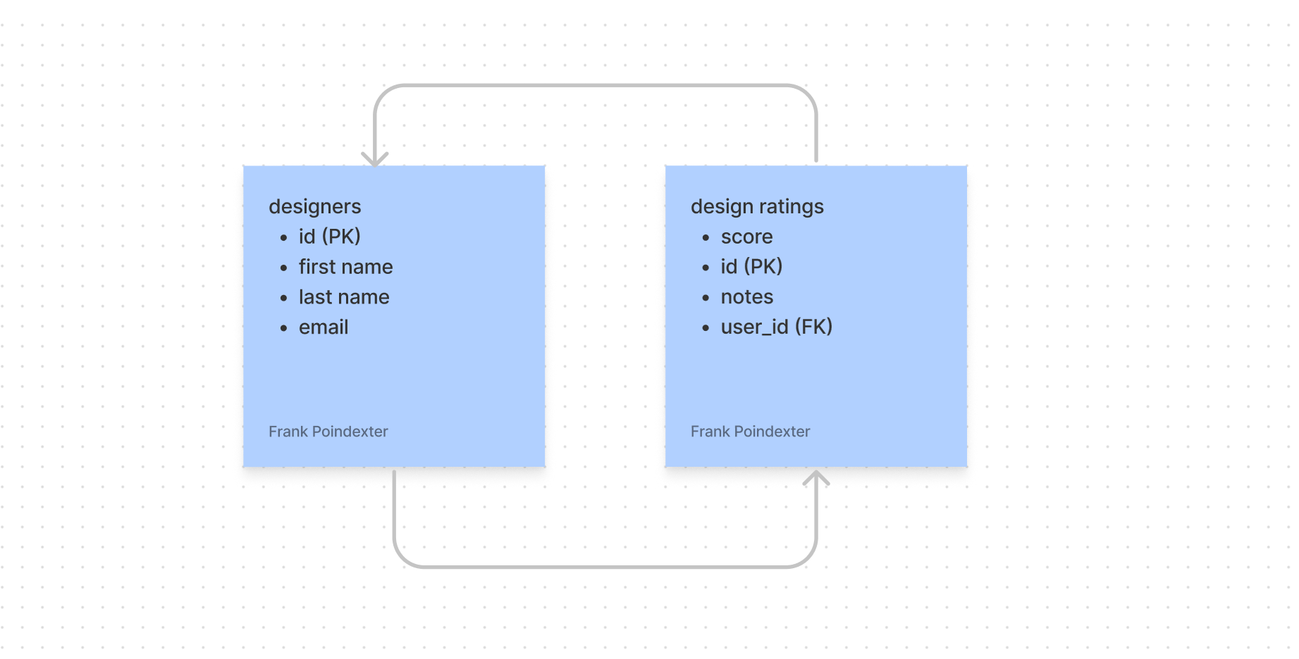
database
1.Create Project
2.Copy the relevant database info (url, key, ect)
3.Copy database info (port, data base name, host)
4.Create data base tables
5. Test database in browser

Slide 10
Js Code
Logic
Set variables for elements
functions for logic
Use Fetch(), .Then(), .Catch() server data api
Add event listeners
Employed filter(),map() to manipulate the js object

Slide 11
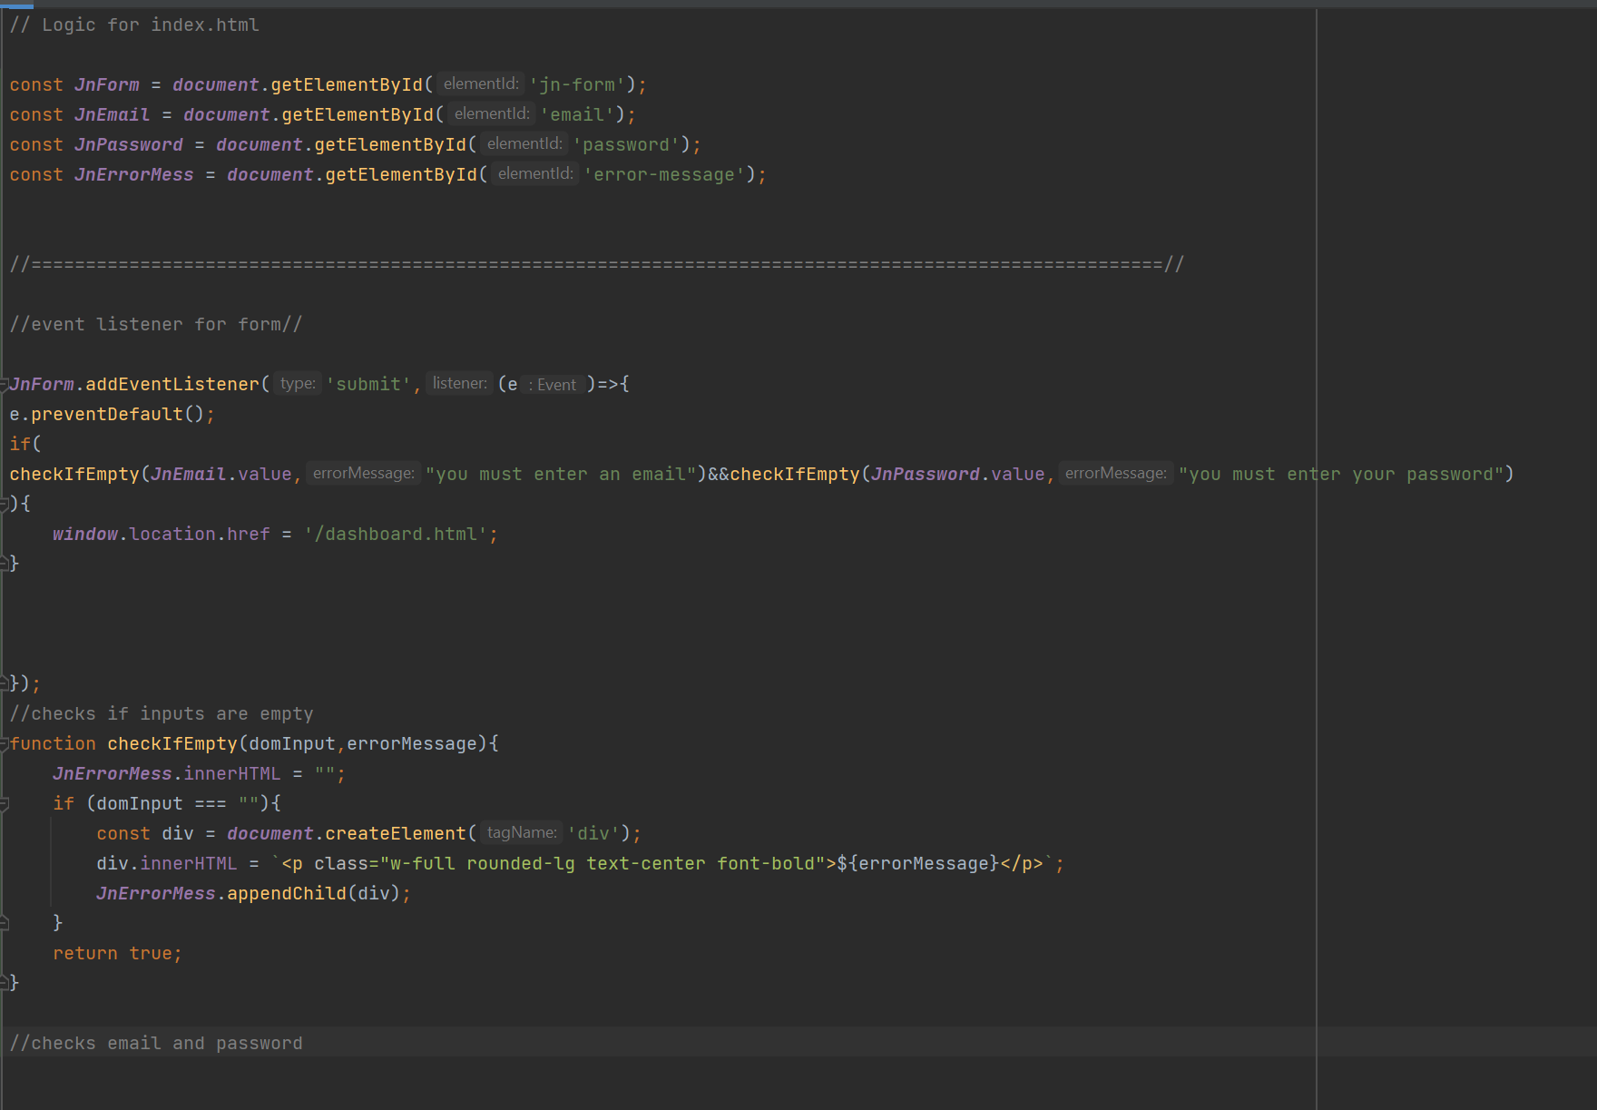
JavaScript
JAVASCRIPT
Created js. folder
Created first js. File app.js for index page
Created second js. File dashboard.js
Validated inputs for app.js file
Created event listener for the index page sign in form directing user to dashboard page
Validated inputs for dashboard.js
Created event listener for the dashboard form which enabled user to add their story to company intranet

